Slide 1
Introduction to Computer Programming Lecture 11.4:
Review : Imported modules – Numpy & Matplotlib
Hemma Philamore
Department of Engineering Mathematics

Slide 2

Import
Import modules using import keyword
Renaming
Importing sub-modules
Importing specific functions, variables

Slide 3
Numpy

Slide 4

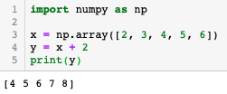





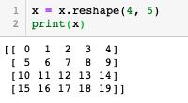
Numpy Array
Pure Python
Numpy
Elementwise operation
Create 1D array from list
arange
Simpler way to add 2 to each element
Creating Numpy arrays
Reshape
ones
linspace

Slide 5











Numpy Functionality
matrix
Trigonometry
Find instances of a value in an array
Exponents and logarithms
Linear algebra
Test if all or any elements in a data structure are non-zero
max
min
n vals
Random numbers

Slide 6
Q.11.4.A
Create the numpy array:
[[6, 8, 10],
[12, 14, 16],
[18, 20, 22]]
Q.11.4.B
Find sin(x) for each value, x, in the list: $\left[\frac{π}{2}\text{, }π\text{, }\frac{π}{4}\right]$
Q.11.4.C
Add [6, 4, 2] to each row of the array in your answer to Q.11.4.A to get:
[[12, 12, 12],
[18, 18, 18],
[24, 24, 24]]
Q.11.4.D
Find the dot product of the four elements in the upper left corners of the 3x3 arrays in Q.11.4.A and Q.11.4.C

Slide 7
Matplotlib

Slide 8
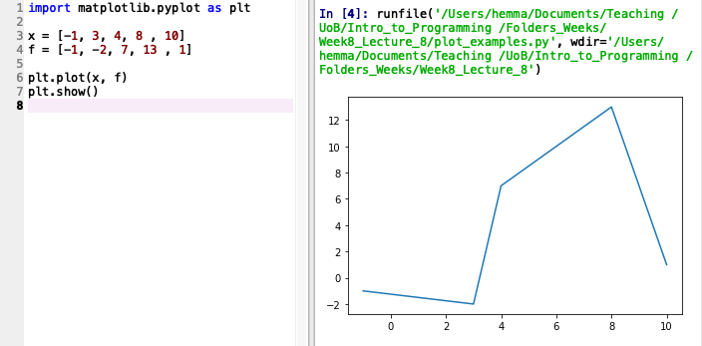
Visualising data
Output displayed in:
Plots window (run in Spyder)
Separate window (run in terminal)
Import the module
Line plot
Required to display plot

Slide 9
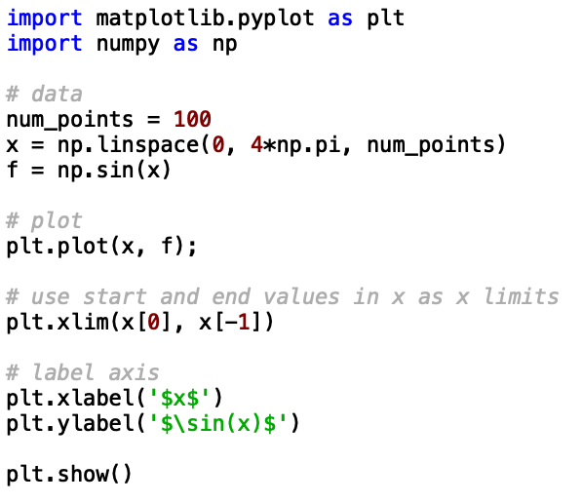
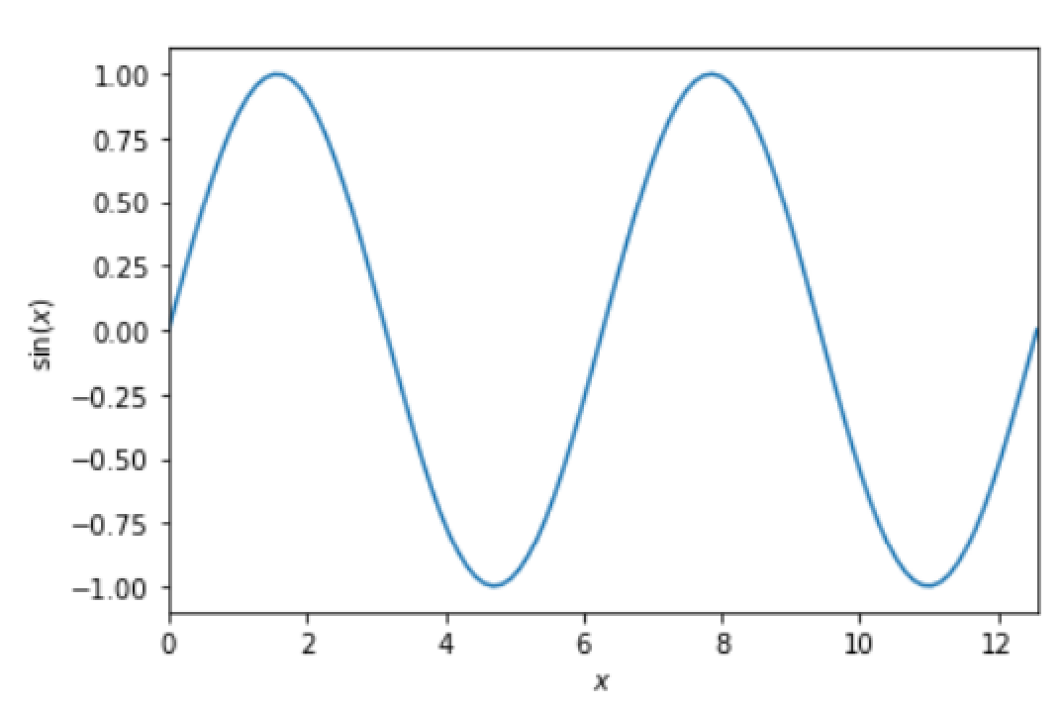
Line plot

Slide 10
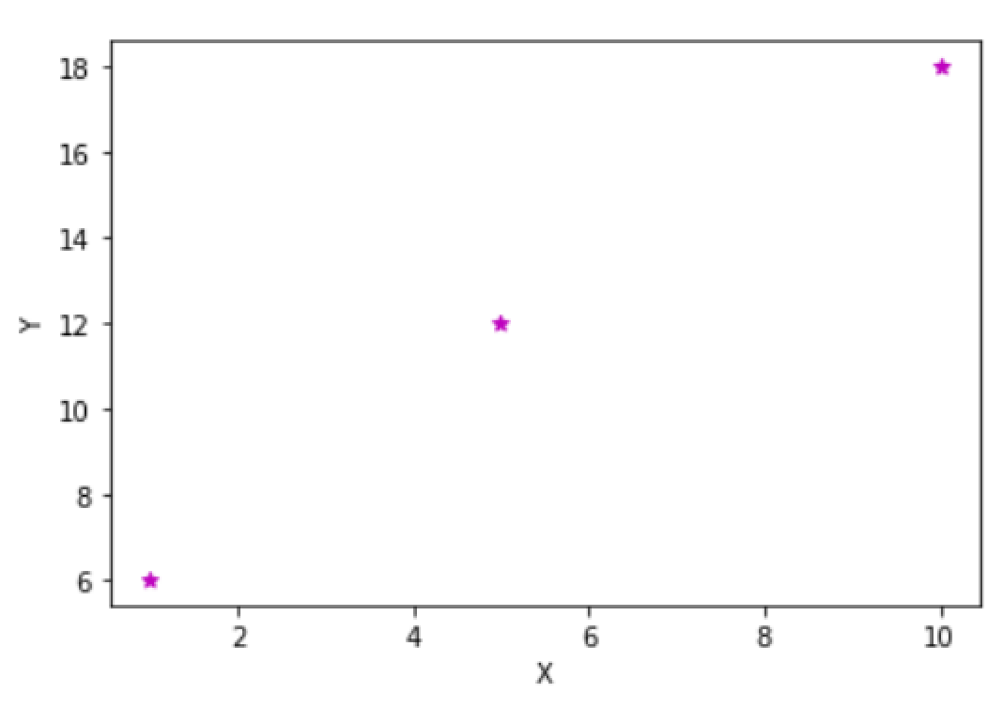
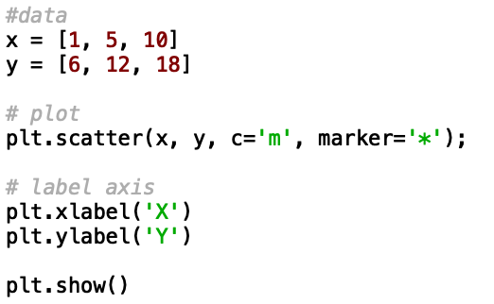
Scatter plot

Slide 11
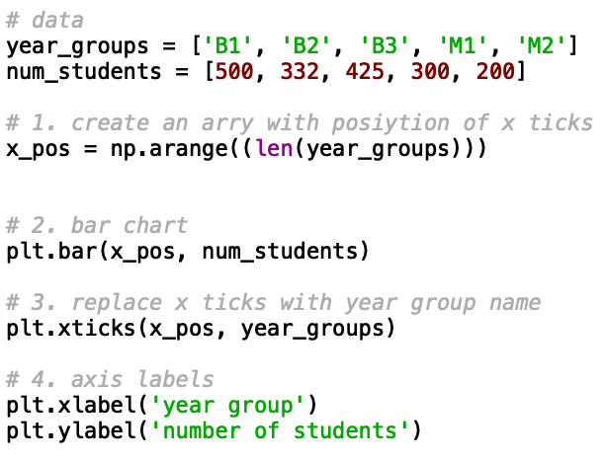
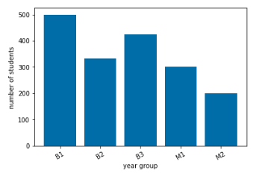
Bar Chart

Slide 12
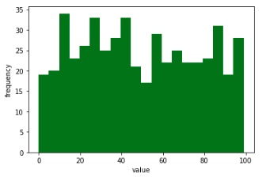

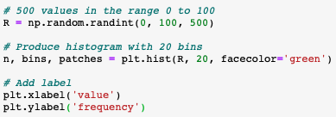
Histogram

Slide 13
Q.11.4.E
Create a line plot of row 1 against row 0 of the numpy array:
[[6, 8, 10],
[18, 23, 12]]
Q.11.4.F
Create a scatter plot of the exponential function, $e^{x}$, for $x$ in the range 0 to 10 inclusive.

Slide 14
Going further with Numpy, Matplotlib and other python modules
Numpy
Mathematical modelling, scientific computing
Matplotlib
Overlaying plots e.g. error bars, subplots, 3D plotting, simulation, animated plots
Scipy : Numerical routines e.g numerical integration, interpolation, optimization, linear algebra, statistics
Sympy : Symbolic mathematics
Pandas : Data analysis and manipulation

